Slide 1

Nano-technology enhanced biosensor for early bacterial sepsis detection / Sepsis biomarker analysis using SERS based sensor
Masters Project Report – 3rd Semester
Dr. Mohamed Zaki Hafeez Sukesh P
M24IM1002 M24IM1007
Masters in Medical Technologies
IIT Jodhpur & AIIMS Jodhpur
November 2025

Slide 2
Clinical Urgency of Sepsis
• 49M cases, 11M deaths annually
• 85% of deaths in low-resource settings
• Delayed diagnosis increases mortality
• Empirical antibiotics prescribed without pathogen knowledge
• Contributing to antimicrobial resistance crisis
• Critical Need: Rapid, bacterial-specific point-of-care diagnostic

Slide 3
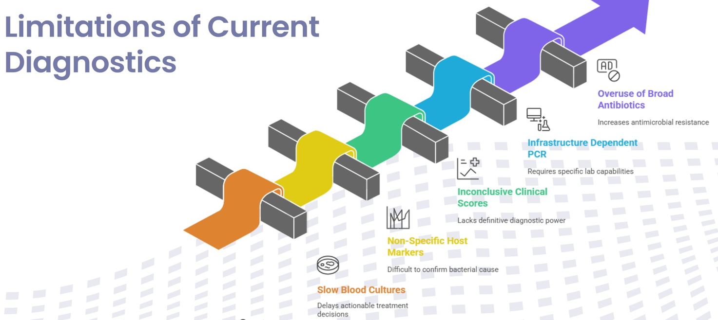
Diagnostic Gap – Problem Statement
• Blood Culture: 24–72 hrs, bacterial-specific, slow
• PCT/CRP Biomarkers: 1–2 hrs, non-specific
• PCR Methods: 1–6 hrs, target-dependent, expensive
• SERS Solution: <30 min, bacterial-specific, novel approach

Slide 4
Current Diagnostic Methods & Limitations
Blood culture delays ? antibiotic overuse
Biomarkers cannot distinguish bacterial vs viral/fungal
PCR requires pre-selected targets, expensive
Conclusion: Need for novel diagnostic approach

Slide 5
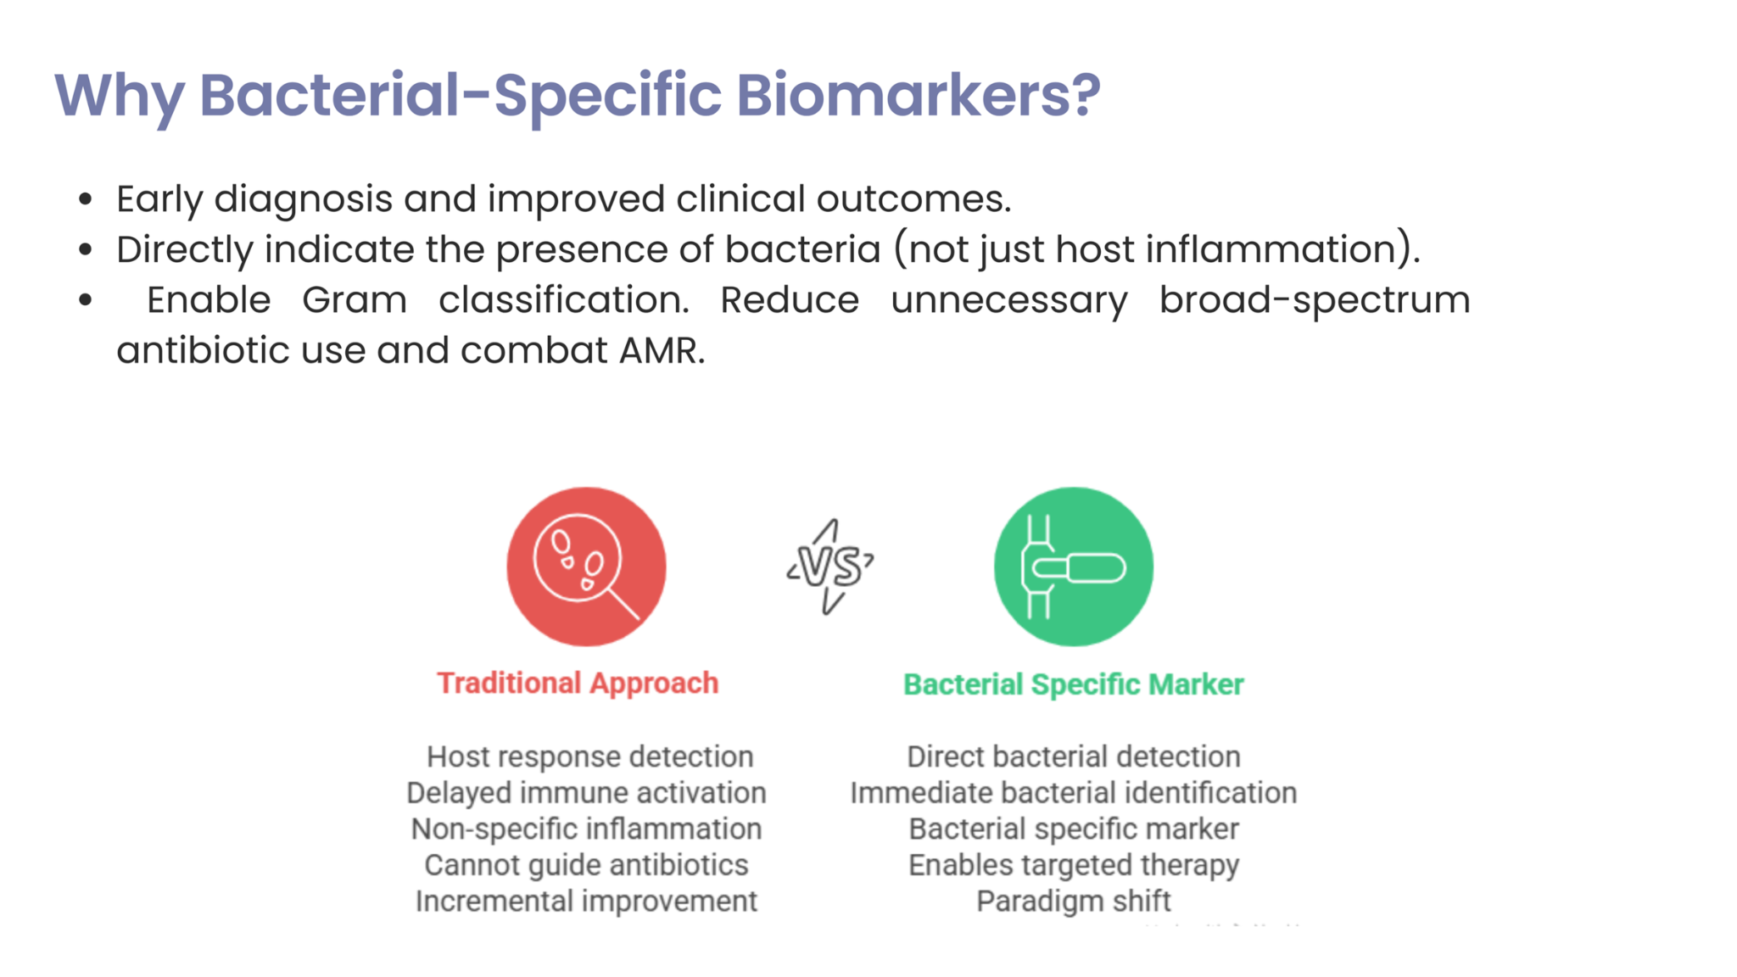

Slide 6
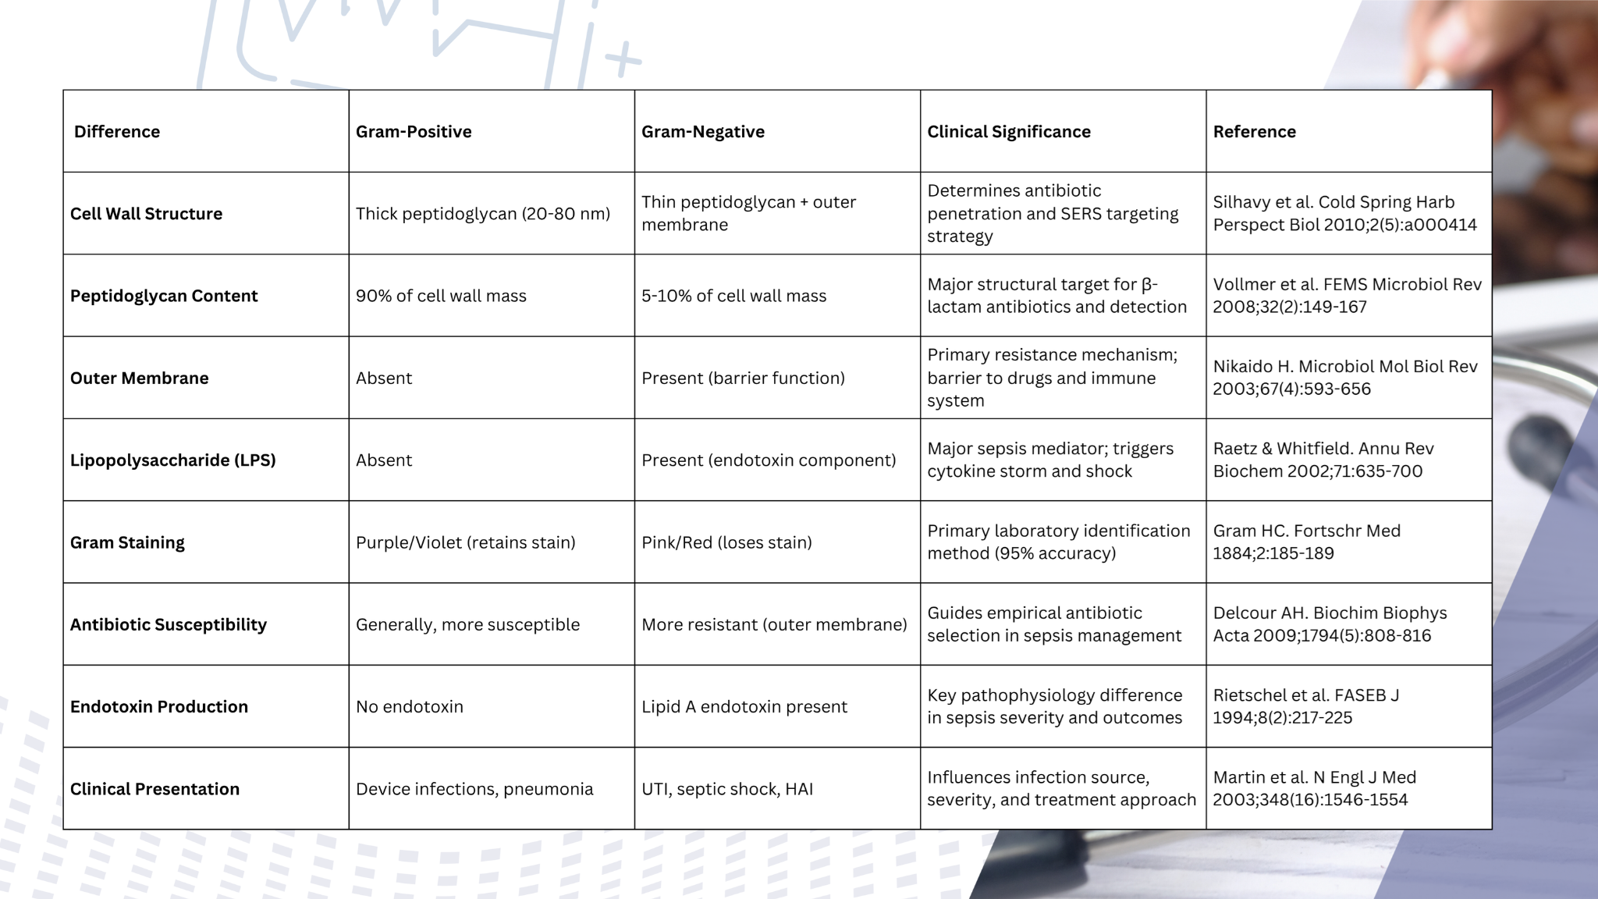
Background

Slide 7
Emerging Biosensor Technologies
Electrochemical biosensors: rapid but limited validation
Optical biosensors (SPR): label-free but complex instrumentation
SERS
Why SERS? – Scientific Rationale
• Enhancement factor: 10^6–10^14; ~100x better than alternatives
• Plasmonic enhancement mechanism amplifies Raman signals
• Molecular fingerprinting without labels or amplification
• Clinical feasibility with Au–Ag nanostructures
• Literature support: publications validating SERS

Slide 8
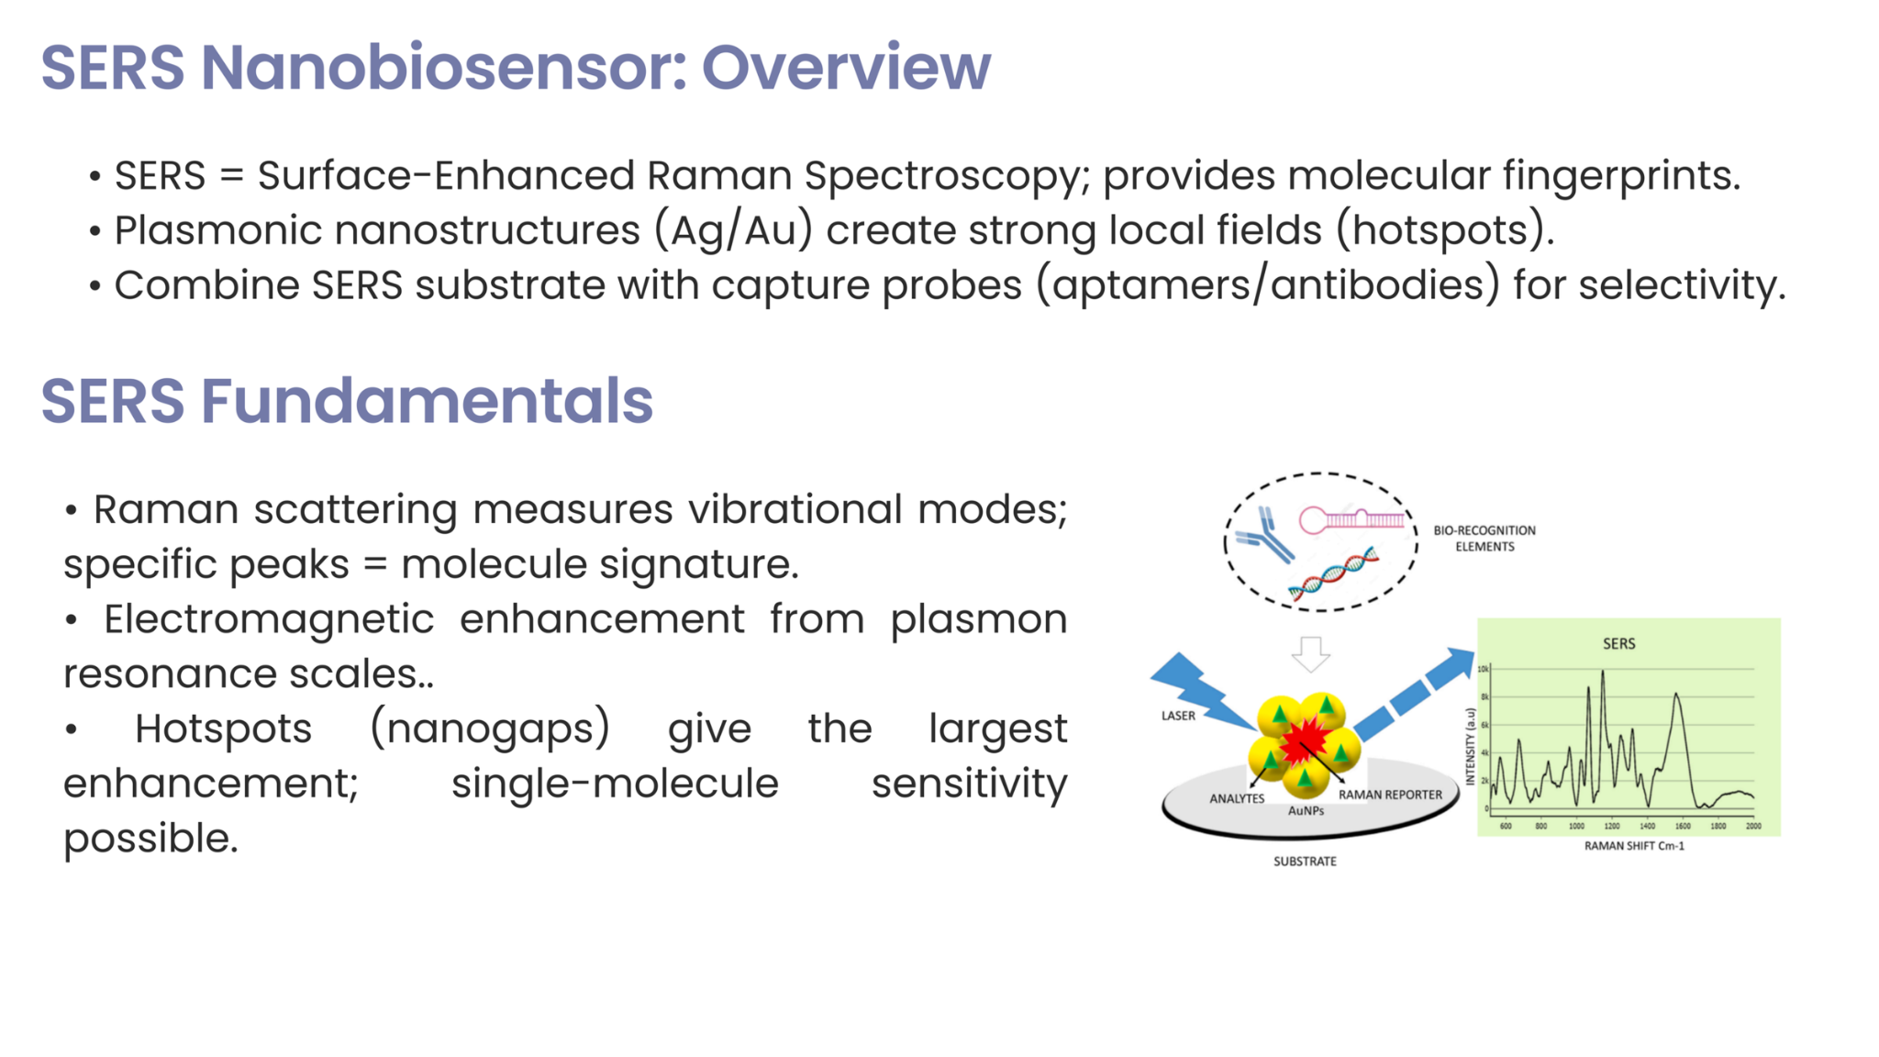

Slide 9
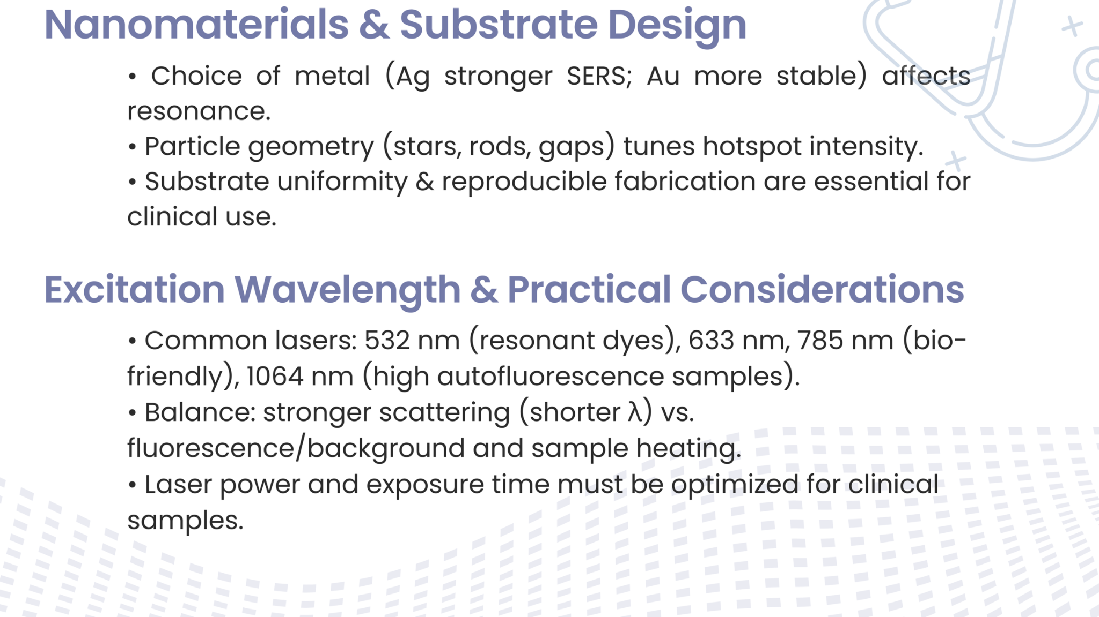

Slide 10
Project Objectives
Design Ag/Au bimetallic SERS substrates (target EF > 10^8; size 10–100 nm)
Identify Raman signatures: PGN (universal), LPS (Gram–), LTA (Gram+)
Rapid, label-free detection: 50–100 µL plasma; femtomolar sensitivity; total workflow 25–35 minutes
POC feasibility: portable instrumentation; <30 min turnaround; USD 2–5 per test; automated analysis

Slide 11
Methodology – Workflow
Literature review and biomarker selection
Fabrication of SERS substrates on silicon with Ag/Au nanostructures
Standardization of sample deposition techniques
Raman spectral acquisition using bench-top Raman system
Preprocessing: baseline correction, normalization, noise filtering
Feature extraction and peak assignment
Machine learning–assisted spectral classification (future phase)
Comparative analysis with traditional biomarker assays (planned)

Slide 12
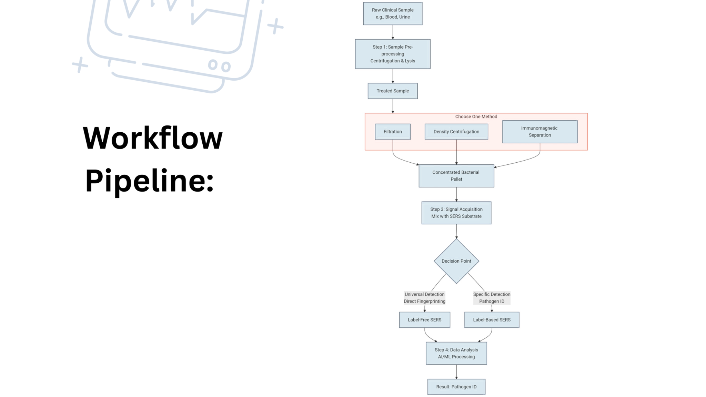

Slide 13
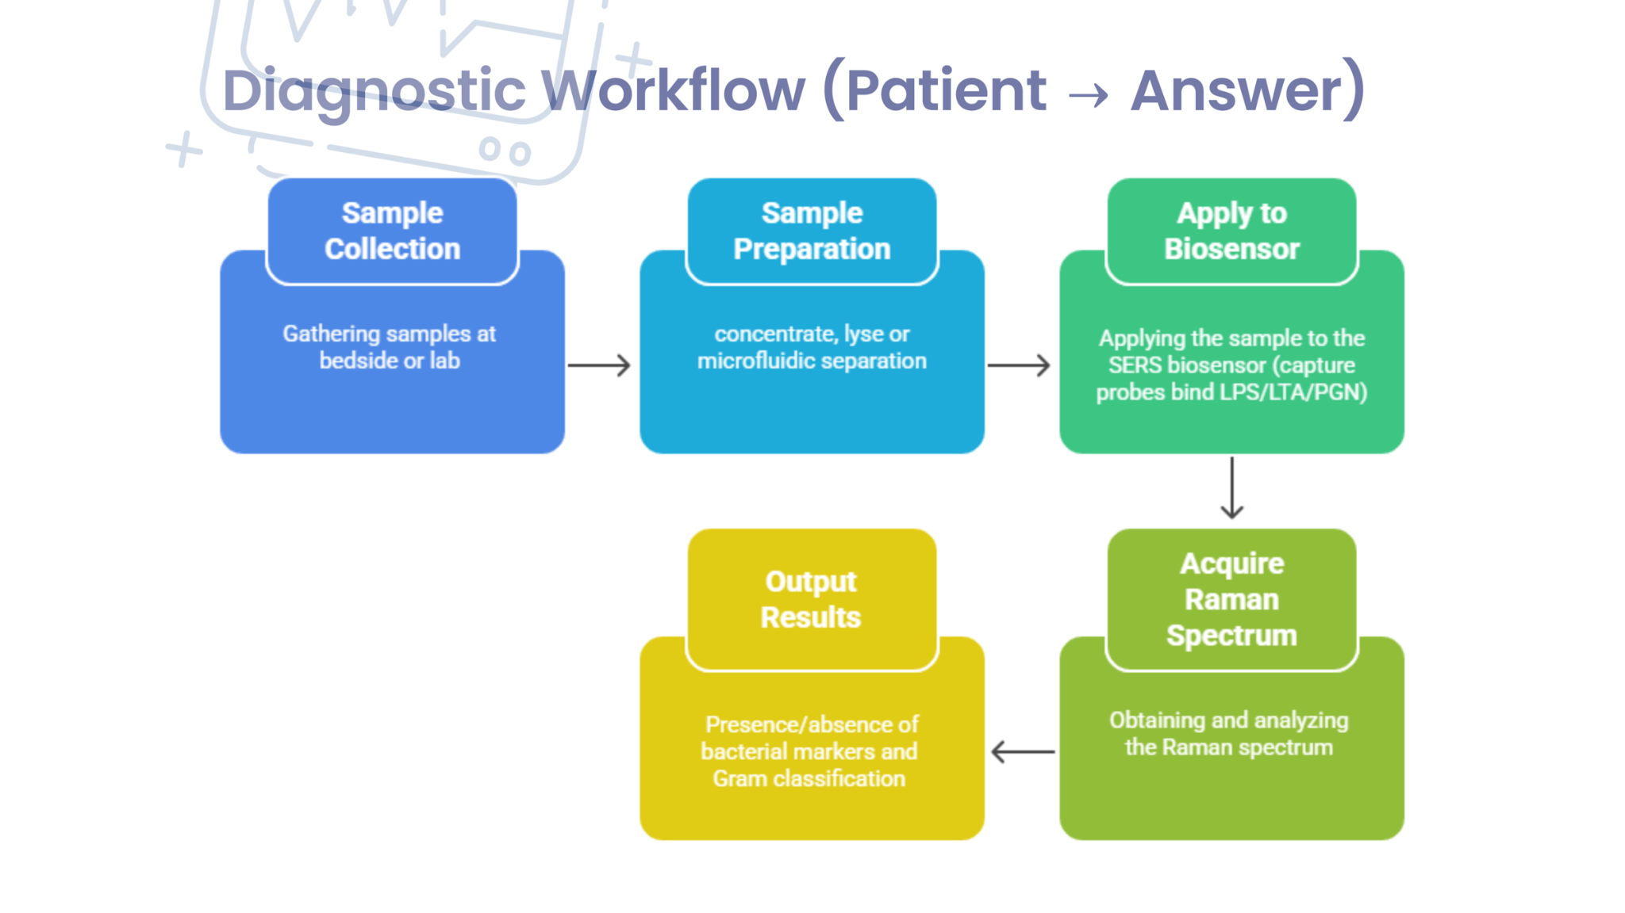

Slide 14
Work completed
Literature Survey on Bacterial-Specific Biomarkers for SERS-Based Sepsis Detection:
Conducted comprehensive systematic review of research publications , analyzing bacterial-specific surface biomarkers with established Raman spectroscopic signatures and demonstrated SERS detectability. Critical evaluation of biomarkers superior to traditional host-response markers (PCT, CRP) for enabling rapid, bacterial-specific sepsis diagnosis.
​Collaborative Review Meetings with Principal Investigators and Research Team:
Conducted multiple strategic review meetings with project supervisors and research collaborators to discuss preliminary findings, obtain expert input on biomarker selection rationale, and identify optimization priorities.
Meetings resulted in: Confirmation of biomarker panel selection aligning with clinical sepsis diagnostic needs. Molecular simulations suggestions with optimization and frequency analysis and strategic planning for next phase approach​es.

Slide 15
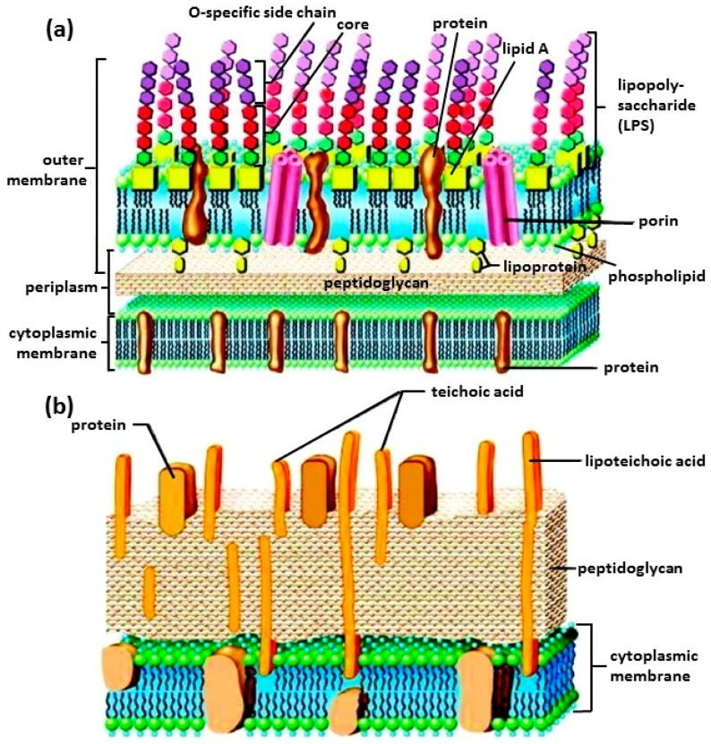
Finalization of Bacterial Biomarker Panel:
Focus Area
Markers specific to the surface of bacteria and not overlapping with other pathogens / Readily available or expressible markers only in bacteria.
Help healthcare professionals with confirmation of a bacterial infection and subsequent gram classification for early diagnosis and treatment and SERS based detection compatibility.
Rationale for biomarkers selection:
1.Universal Bacterial Detection :N-acetylmuramic acid
Exclusivity:
Present in ALL bacteria, absent in viruses/fungi/parasites
Direct bacterial confirmation
Unique to bacterial peptidoglycan only

Slide 16
2. Gram classification
2.a Gram-Positive–Specific Markers : Lipoteichoic Acid (LTA)
Uniqueness:
Only in Gram-positive bacteria , surface accessibility .
2b. Gram Negative specific marker :Lipopolysaccharides (Lipid A , O antigen)
Uniqueness:
Only in Gram-negative bacteria, absent in all other organisms
Strong enhancement, endotoxin correlation .
Established optimized three-component biomarker panel: (1)N-acetylmuramic acid (PGN) - universal bacterial detection marker present in all (2) Lipopolysaccharide (LPS) - Gram-negative specific marker (3) Lipoteichoic Acid (LTA) - Gram-positive specific marker.
Panel selected based on biomarker exclusivity to bacteria, surface accessibility for SERS detection, and Gram classification capability.​​
These markers can be supplemented with bacterial-specific components to enhance detection sensitivity in complex cases where signals might be obscured.

Slide 17
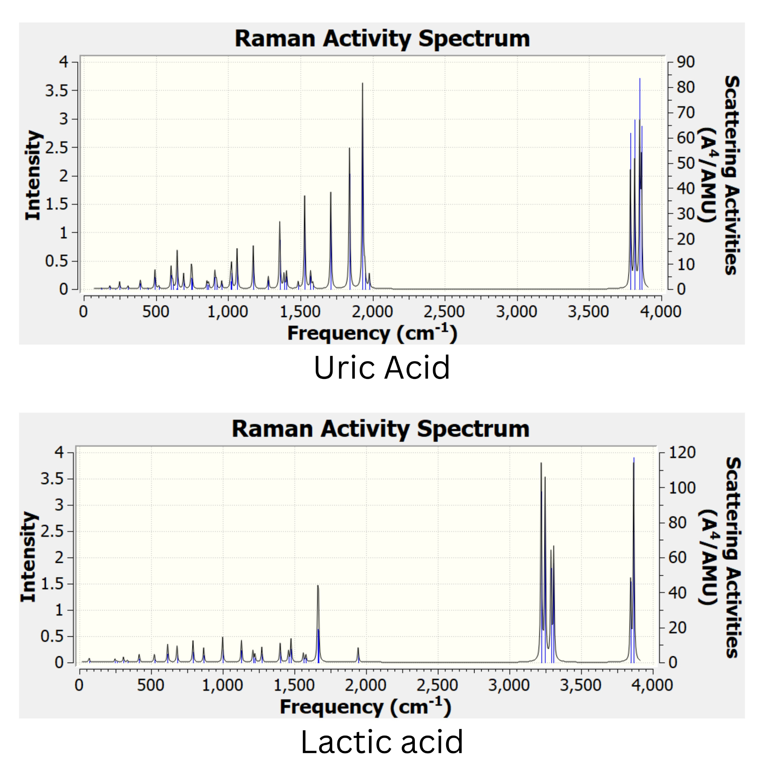
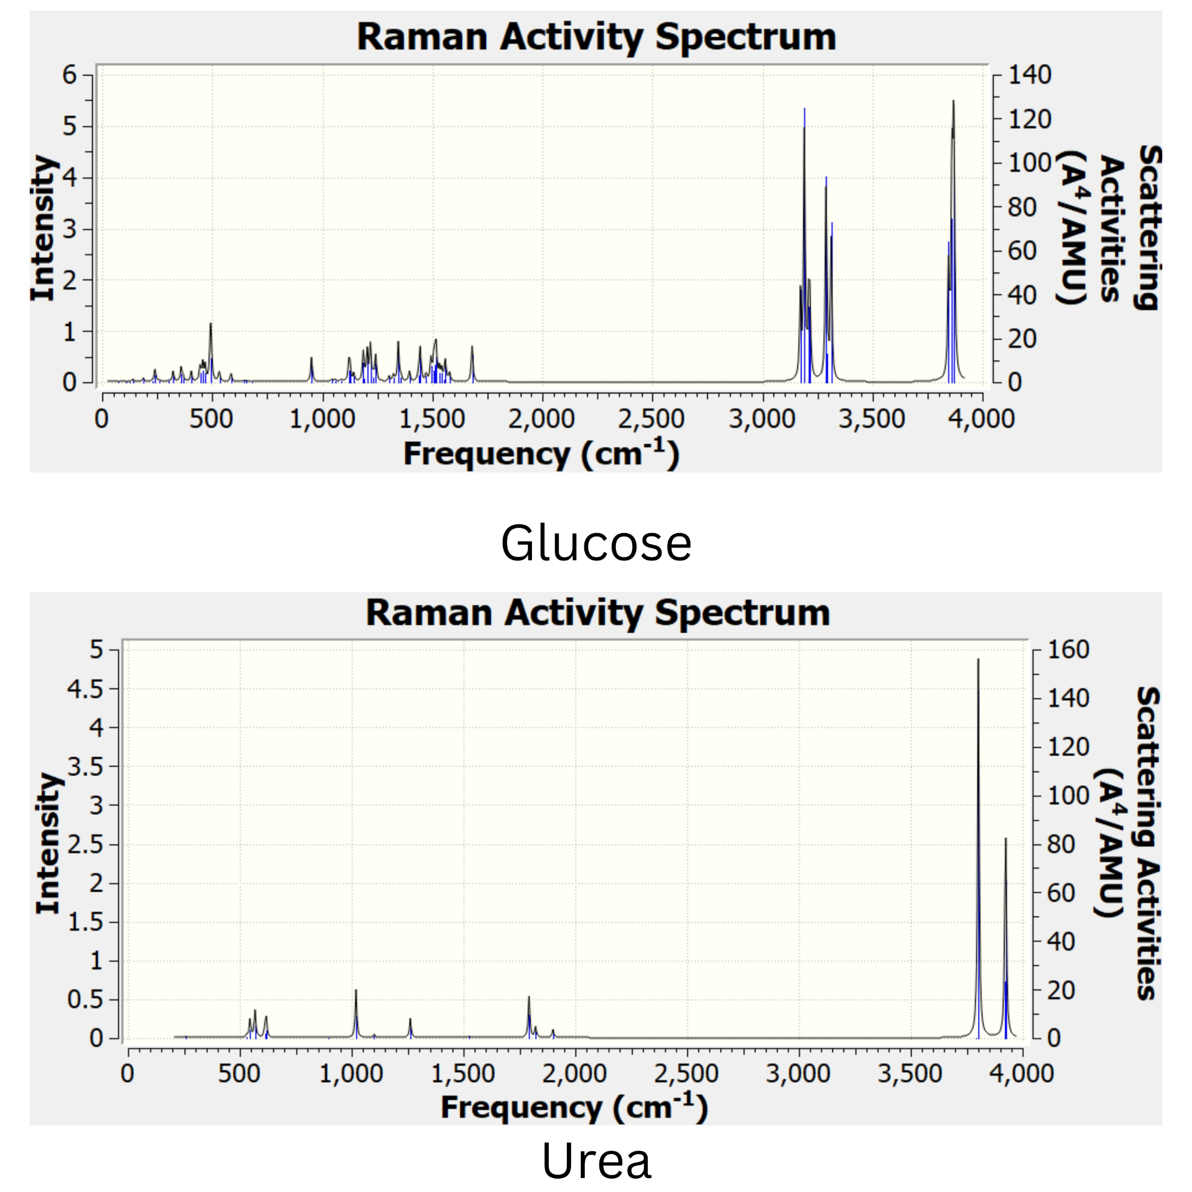
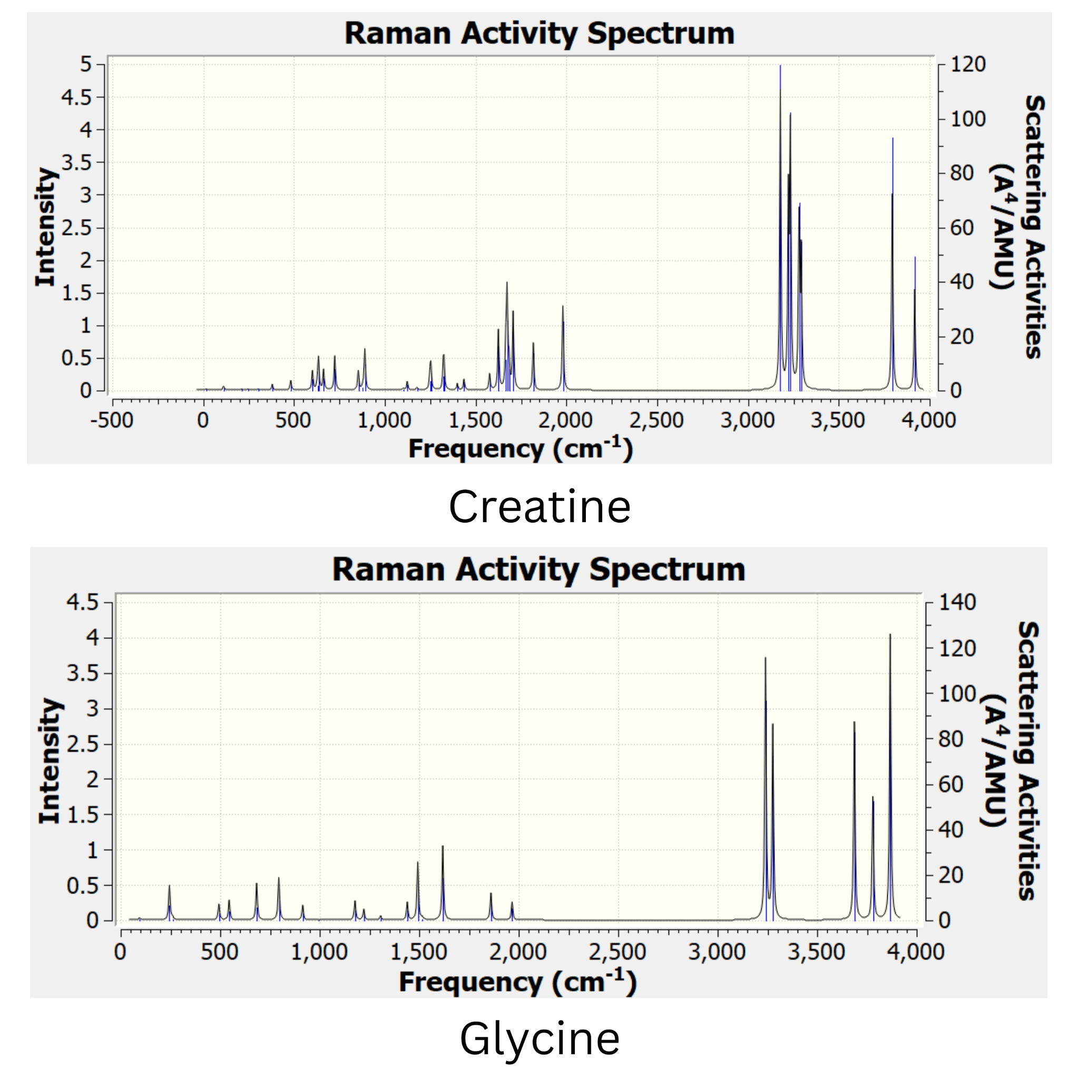
Optimization and Preliminary SERS Characterization with Test Molecules:
Initiated experimental optimization of SERS and Raman Spectral Acquisition and Preliminary Preprocessing. Reviewing of Raman Peaks Assignment and Biomarker Signature Identification for reliable biomarker discrimination using software simulation
Simulations pertaining to Raman optimization and frequency using basic molecules using Gaussian.

Slide 18
Groundwork for Interpretation and analysis of raman spectrum using libraries and comparative analysis with literature along with preliminary wavelength assessment review
Library-Based Matching:
Using open molecular Raman libraries (e.g., Raman Open Database, RamanKit, SpectraBase).
Match measured peaks with standard fingerprint regions for biomolecules (proteins, lipids, bacterial cell-wall components).
Comparative Literature Analysis: Verification of identified peaks with published spectra for sepsis biomarkers (PGN, LPS, LTA, CRP, IL-6, etc.).
Outcome A structured base to validate SERS spectral peaks against known molecular vibrational signatures.
Preliminary Wavelength Assessment & Replication of Literature Spectrum
We are currently replicating the Raman acquisition protocol used in the selected reference study.
Preliminary measurements at 785 nm are ongoing, and our goal is to achieve comparable peak positions and intensities for validating our SERS substrate performance.

Slide 19
Initiation of Pure Biomarker Sample Procurement Procedures
Initiation of procurement procedures for commercially available high-purity bacterial biomarker standards: Trying to establish purchase with quality control specifications ensuring received biomarkers meet analytical standards for SERS characterization and clinical validation studies.​​
Planning and Strategy for Next Phase of Work
Developed comprehensive roadmap for subsequent project phases: completion of SERS substrate optimization with pure biomarker standards, establishment of calibration curves, reproducibility assessment across multiple substrate batches; - prospective validation with clinical samples, exploring machine learning model development.​​
Exploring Feasibility of Portable, Low-Cost POC Raman Device suitable for clinical deployment. automated spectral analysis algorithms for rapid biomarker identification without requiring specialized operator training; integration into emergency department and ICU workflows enabling true point-of-care deployment.

Slide 20
Novelty
No identical patent
Novel use of PGN + LPS + LTA with SERS
Integrated POC SERS workflow = patentable
Competitive Advantage & Market Differentiation
Feature | Blood Culture | PCT/CRP Tests | SERS Biosensor
Time-to-Result | 24-72 hours | ~1 hour | < 30 MINUTES *
Pathogen Specificity | Yes | No | YES (Bacterial & Gram-Type)
AMR Guidance | Delayed | No | IMMEDIATE
Platform | Central Lab | Point-of-Care | POINT-OF-CARE

Slide 21
Impact
Clinical & Societal Impact
Early targeted therapy = reduced mortality
Narrow-spectrum antibiotics reduce AMR
Affordable point-of-care solution and healthcare savings
Market opportunity
Sepsis diagnostics: $1.14B ? $2.5B (2030)
SERS biosensors: $412M ? $1.38B (2033)
High revenue potential

Slide 22
Challenges
Reproducibility of SERS substrates across batches with Batch-to-batch nanoparticle variation affecting enhancement factors
Matrix Interference: Blood components cause non-specific signals
Biological variability in plasma samples and Noise/interference in real patient samples
Sensitivity Achievement: Detecting clinically relevant biomarker concentrations requires optimization
Integration of Raman hardware into a compact POC system
Need for large-scale clinical validation
Regulatory approval challenges for medical diagnostics and devices
Clinical Adoption: Overcoming clinical practice inertia and technology skepticism

Slide 23
Conclusion
• SERS nano-biosensor offers rapid, bacterial-specific sepsis diagnostics
• Novel integrated workflow with Gram classification
• Potential to transform sepsis management globally.
This preliminary project phase has successfully established the scientific and technical foundation for developing a SERS-based nano-biosensor platform for rapid bacterial-specific sepsis diagnostics.

Slide 24
References
Schultz et al., "Sepsis," Nat. Rev. Dis. Primers, vol. 6, p. 60, 2020.
M. Singer et al., "The Third International Consensus Definitions for Sepsis and Septic Shock (Sepsis-3)," JAMA, vol.315, no. 8,pp. 801–810, 2016.
L. Evans et al., "Surviving Sepsis Campaign: International Guidelines for Management of Sepsis and Septic Shock 2021," Crit. Care Med., vol. 49, no. 11, pp. e1063–e1143, 2021.
J. Langer et al., "Present and Future of Surface-Enhanced Raman Scattering," ACS Nano, vol. 14, no. 1, pp. 28–117, 2019.
C. Zhou et al., "Recent advances and prospects in nanomaterials for bacterial sepsis management," J. Mater. Chem. B, vol. 11, no. 45, pp. 10778–10792, 2023.
M. Hassan et al., "Recent Advances in Bacterial Detection Using Surface-Enhanced Raman Scattering," Biosensors (Basel), vol. 14, no. 8, p. 375, 2024.
C. Derichsweiler et al., "Optical Bionanosensors for Sepsis Diagnostics," Small Methods, vol. 9, no. 1, p. 2301234, 2025.
B. Bonini et al., "Emerging Biosensing Technologies towards Early Sepsis Diagnosis and Management," Biosensors (Basel), vol. 12, no. 10, p. 894, 2022.
P. Sondhi et al., "Nanomaterials for Biosensing Lipopolysaccharide," Biosensors (Basel), vol. 10, no. 1, p. 2, 2019.
C. Mobed et al., "Environmental protection based on the nanobiosensing of bacterial lipopolysaccharides: material and method overview," Environ. Sci. Pollut. Res., vol. 29, pp. 24202–24223, 2022.
E. Nine et al., "SERS-based antibiotic susceptibility testing: Towards point-of-care clinical diagnostics," Biosens. Bioelectron., vol. 219, p. 114830, 2023.
C. Weinstein et al., "Controlled Optimized Broth Media Improves Detection of Bloodstream Infections," J. Clin. Microbiol., vol. 42, no. 10, pp. 4627–4631, 2004.
D. Iredell et al., "Pathogenic Neisseria meningitidis capsular group W135 emerge," Emerg. Infect. Dis., vol. 8, no. 1, pp. 98–102, 2002.
O. Schneewind and D. Missiakas, "Lipoteichoic acids, phosphate-containing polymers in the envelope of gram-positive bacteria," J. Bacteriol., vol. 196, no. 6, pp. 1133–1142, 2014.
N. Kotoulas et al., "Differentiating bacteria by their unique surface interactions," PLoS ONE, vol. 20, no. 6, pe0327489, 2025.
T. Tan and N. S. Mohamad, "Electrochemical Aptamer-Based Biosensors for Sepsis Diagnosis: Recent Advances and Future Perspectives," Biosensors (Basel), vol. 15, no. 7, p. 402, 2025.
Y. Liu et al., "A reproducible gold SERS substrate assisted by silver nanoparticles," Analyst, vol. 141, no. 18, pp. 5170–5178, 2016.
C. H. Lai et al., "Near infrared surface-enhanced Raman scattering based on star-shaped gold/silver nanoparticles," Sci. Rep., vol. 7, p. 5446, 2017.
Y. Yang et al., "Gold and silver nanoparticles for SERS applications," Nanomaterials, vol. 9, no. 7, p. 1014, 2020.
C. C. Burda et al., "Chemistry and properties of nanocrystals of different shapes," Chem. Rev., vol. 105, no. 4, pp. 1025–1102, 2005.

Slide 25
T. J. Durkin et al., "Rapid Detection of Sepsis: Recent Advances in Biomarker Sensing Platforms," ACS Pharmacol. Transl. Sci., vol. 4, no. 6, pp. 1784–1802, 2021
S.Singhet al."Point-of-Care for Evaluating Antimicrobial Resistance,"ACSPharmacol. Transl. Sci.,vol. 4, no. 6, pp.1838– 1853, 2021
D. Cialla-May et al., "Recent advances of surface enhanced Raman spectroscopy (SERS) in bioanalytical and clinical research," Anal. Bioanal. Chem., vol. 416, pp. 673–704, 2024.
W. Vollmer et al., "Peptidoglycan structure and architecture," FEMS Microbiol. Rev., vol. 32, no. 2, pp. 149–167, 2008.
E. T. Rietschel et al., "Bacterial endotoxin: molecular relationships of structure to activity and function," FASEB J., vol. 8, no. 2,pp. 217–225, 1994.
K. T. Schultz et al., "Point-of-care rapid sepsis diagnostics," Lancet Infect. Dis., vol. 21, no. 1, pp. e1–e14, 2021.
A. Mobed et al., "Bacterial biomarker detection methods," Biosens. Bioelectron., vol. 165, p. 112431, 2020.
World Bank, "Global Sepsis Burden and Economic Impact," 2020.
SNS Insider, "Sepsis Diagnostics Market Report 2032," 2024.
N. E. Dina et al., "SERS-based microdevices for use as in vitro diagnostic biosensors," Chem. Soc. Rev., vol. 53, pp. 1102–1145, 2024.
M. Reali et al., "Novel diagnostics for point-of-care bacterial detection and identification," Chem. Soc. Rev., vol. 48, pp. 1448– 1472, 2019.
Y. Yang et al., "Specific and quantitative detection of bacteria based on surface cell imprinted SERS," Biosens. Bioelectron., vol. 215, p. 114524, 2022.
A. Kundu et al., "Ultrasensitive and label-free detection of biomarkers on AgNP-laden black phosphorus SERS platform," Sens. Diagn., vol. 1, pp. 1156–1167, 2022.
N. Verma et al., "Gram-positive bacterial identification," J. Microbiol. Methods, vol. 179, p. 106086, 2021.
Takahashi et al., "Early antibiotic therapy and survival in sepsis," Crit. Care Med., vol. 45, no. 6, pp. 967–974, 2017.

Slide 26


